Slide 1
Good Study Habits
Harry Xie (p2211355)
19 April 2024

Slide 2
Child
Junior
Adults
University
Senior
Bachelor

Slide 3
Points
Building Interest
Preview
Mapping

Slide 4

Building Interest
Interest is the best teacher

Slide 5
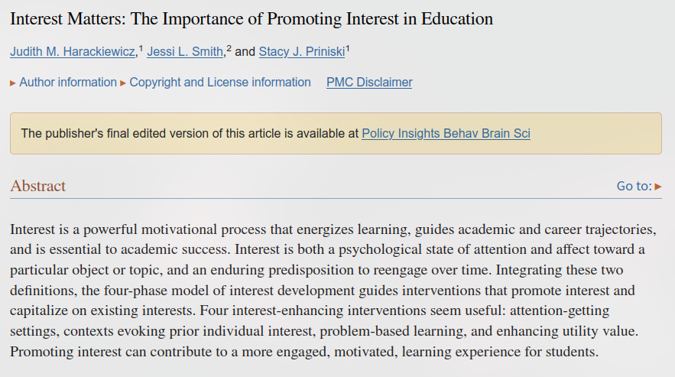
Screenshot of the essay

Slide 6
01
03
Reading books
Feel accomplishment
02
04
Figure out
Interest built

Slide 7

Preview
Build a basic concept

Slide 8
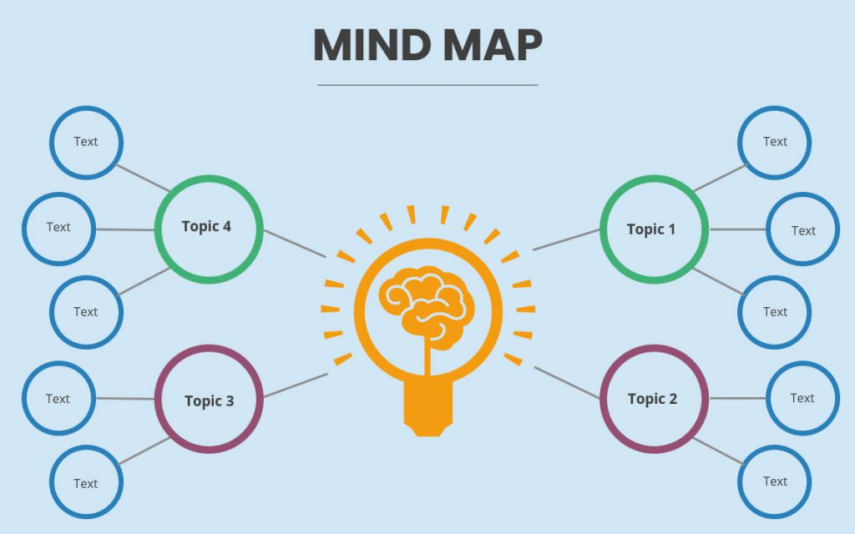
Mapping
Build System

Slide 9
Main topic
Draw branches
Add details

Slide 10
Thanks for Watching!

Slide 11
References
- Harackiewicz JM, Smith JL, Priniski SJ. Interest Matters: The Importance of Promoting Interest in Education. Policy Insights Behav Brain Sci. 2016 Oct;3(2):220-227. doi: 10.1177/2372732216655542. Epub 2016 Jun 30. PMID: 29520371; PMCID: PMC5839644.

